Slide 1






Do not delete this slide.
This slide is designed so that you can copy the prompt box you need and insert it into your slides.
This slide is hidden and will not be included when presenting your lesson.
TRACK WITH ME
VOCABULARY
1 -
HINT
Students, remember….
CHECK FOR UNDERSTANDING
READ WITH ME
TEACHER CUE
MAKE THE CONNECTION
Students, you already know….
EXTENSION
GESTURE WITH ME

Slide 2


I have captured 200 joules of energy from the sun using my homemade solar panel. I hooked it up to the lava lamp in my room and the light output is measured to be 150 Joules. How efficient is the solar panel? Construct an energy flow diagram for the above energy transformation.
Recall the formula for energy efficiency:
$Efficiency=\frac{Useful energy}{Total energy} x 100\%$
$Efficiency=\frac{Total energy}{Useful energy} x 100\%$
Copy these into your workbook!
Energy efficiency simply means using less energy to perform the same task.
If most of the input energy is converted to output energy, the system is said to be relatively efficient.

Slide 3
2 Truths 1 Lie
You have 3 minutes to come up with 2 truths 1 lie.
The goal of this activity is to get to know each other better. Also, it is a good way to see how good of a liar you are.

Slide 4
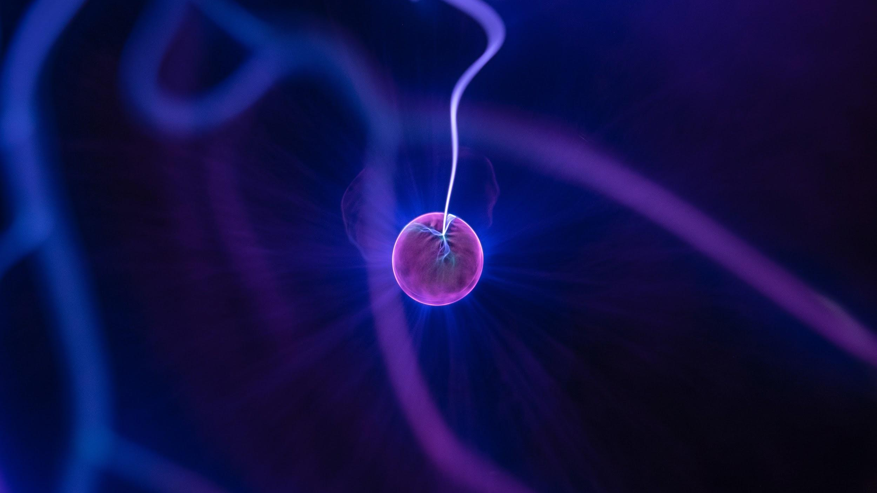

Sound Energy
Notes:
Insert cover image and use transparency settings to fade image.

Slide 5
TRACK WITH ME
Understand sound energy
READ WITH ME
I can define sound energy
I can describe how vibration of particles generate sound
I can describe the term frequency, pitch & volume
DECLARE THE OBJECTIVE
Read the learning objective to your partner.

Slide 6
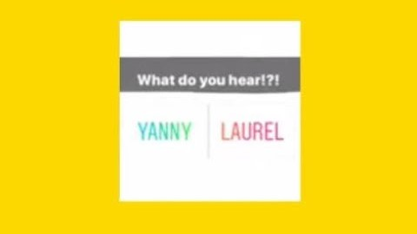
Yanny or Laurel?
Notes:
https://www.youtube.com/watch?v=gdGyvGPZ1G0

Slide 7
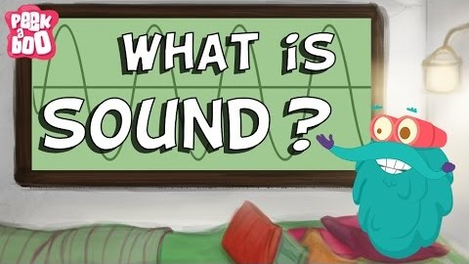
Notes:
https://www.youtube.com/watch?v=gdGyvGPZ1G0

Slide 8
Sounds travel through 3 states of matter:
S________
L _______
G_______
Sound results due to vibration of particles
You cannot hear sound in the outer space because it is vacuum. It means there is NO air molecules to vibrate in order to transmit sound.
Sound energy is considered a type of kinetic energy. (True / False)
Higher frequency gives us higher pitch.
Lower frequency gives us lower pitch
Notes:
https://www.youtube.com/watch?v=gdGyvGPZ1G0

Slide 9
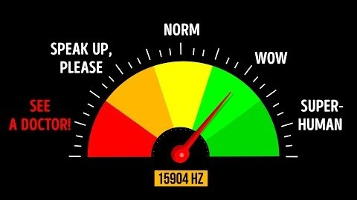
Superhuman Hearing
Frequency

Slide 10
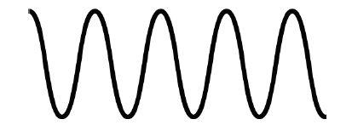
Repeat the opposite word/phrase.
SOUNDWAVES
mechanical wave that results from the back and forth vibration of the particles
Example: In space, sound cannot travel because there is no particle to vibrate.

Slide 11
Repeat the opposite word/phrase.
FREQUENCY
the number of soundwave cycles that occur in one second
Example: A female speaking voice is around 165 Hertz to 255 Hertz while a male speech range is about 80 Hertz to 155 Hertz.

Slide 12
Repeat the opposite word/phrase.
HERTZ
Unit of frequency measurement
Example: The middle C in piano key is around 261 Hertz. An octave lower than middle C is around 130 Hertz.

Slide 13
Repeat the opposite word/phrase.
HERTZ
Unit of frequency measurement
Example: The higher the Hertz, the more soundwaves cycle occur in one second

Slide 14

Which soundwave is considered higher in frequency?

Slide 15
Repeat the opposite word/phrase.
MEDIUM
The matter through which a wave travels
Example: Sound travels in solid, liquid and gas state of matter.

Slide 16
Repeat the opposite word/phrase.
VOLUME
The amplitude or loudness of a sound

Slide 17
Repeat the opposite word/phrase.
DECIBELS
a unit used to measure the intensity of a sound
Example: Sound below 80 dB is generally safe for human ears; anything above 90dB, when exposed to a long period of time will damage the eardrums.

Slide 18
Repeat the opposite word/phrase.
PITCH
How high or how low a sound is
Example: Female generally sing in a higher pitch than male.

Slide 19
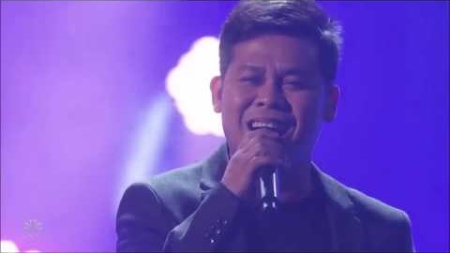
Pitch in Vocal Cord (male vs female)

Slide 20
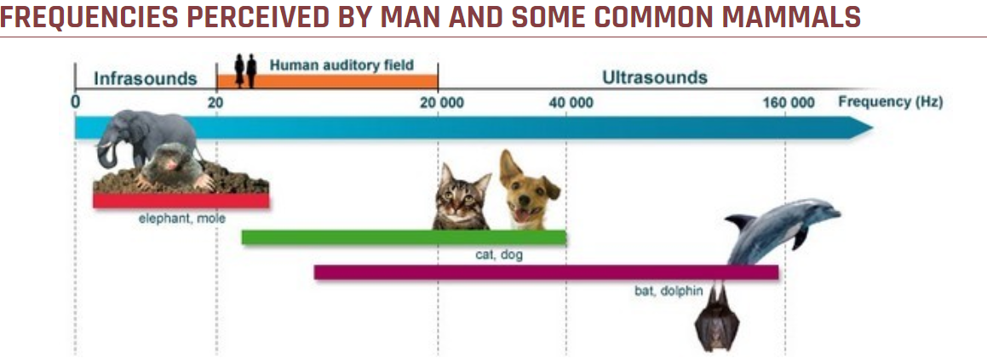
Frequencies Spectrum

Slide 21
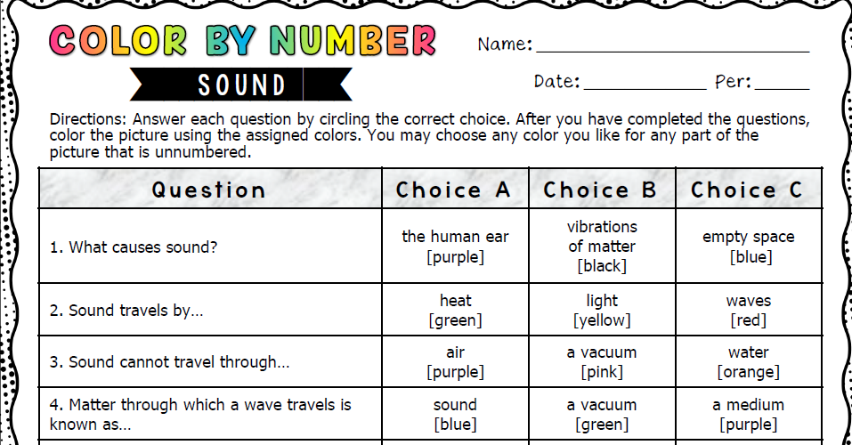
Frequencies Spectrum

Slide 22

Frequencies Spectrum

Slide 23

Frequencies Spectrum

Slide 24
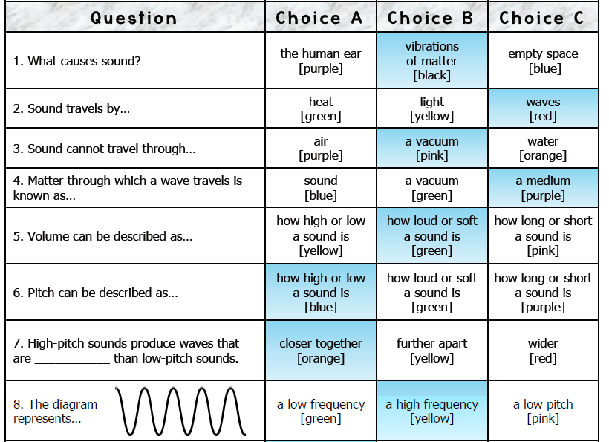
Frequencies Spectrum

Slide 25
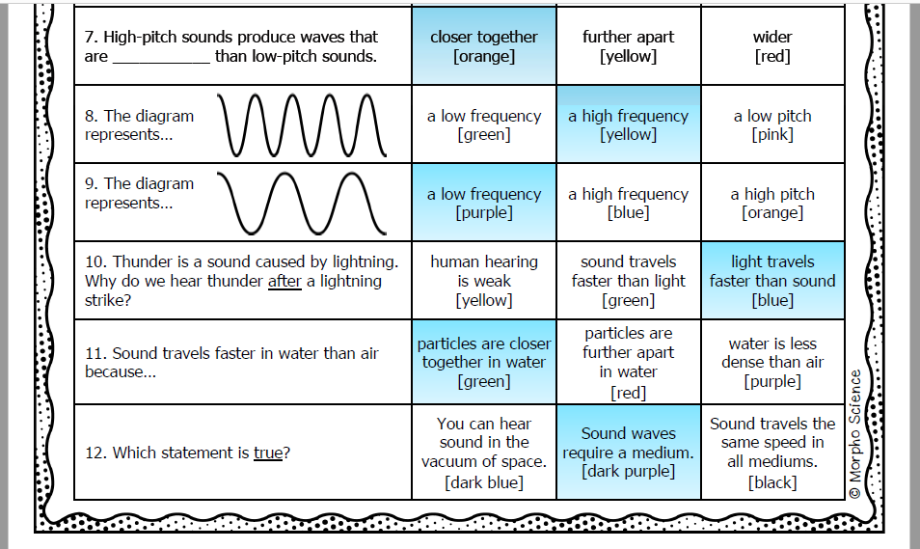
Frequencies Spectrum

